Slide 1

UNIX SHELL PROGRAMMING
THE FILE ATTRIBUTES
PREETHI.P
Department of Computer Science and
Engineering

Slide 2

UNIX SHELL PROGRAMMING
FILE ATTRIBUTES
PREETHI.P
Department of Computer Science and Engineering

Slide 3
UNIX SHELL PROGRAMMING
FILE ATTRIBUTES
Topics to Discuss:
Listing Files
Ls –l
Listing directory options
File permissions
Changing file permissions

Slide 4
UNIX SHELL PROGRAMMING
Listing Files
List of filenames arranged in ASCII collating Sequence.
The ordering Would be
White Space
Numerals
Uppercase and Lowercase

Slide 5
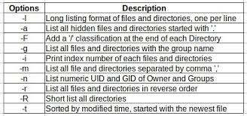
UNIX SHELL PROGRAMMING
Listing Files options
Image ref: linuxteck.com

Slide 6
UNIX SHELL PROGRAMMING
Listing Files options
ls –F : it displays Directory and Executable
ls –a : Showing Hidden Files
.profile contains a set of instructions to be performed when a user log in.
The . And .. Are the special files
Listing a directory :
Recursive Listing: (-R) lists all the files and subdirectories In the directory tree

Slide 7
UNIX SHELL PROGRAMMING
Listing Files options
ls –l Listing File Attributes
Reveals Attributes like Permission, Size, and Ownership Details.
1.Type : -, d, devicefile Permission : rwx
2.Number of links associated with the file.
3.Ownership
4.Group ownership:
5.Size
6.Last Modification time
7.Filename

Slide 8
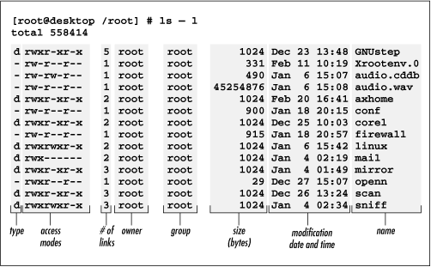
UNIX SHELL PROGRAMMING
Ls –l
Image ref: Pinterest.com

Slide 9
THANK YOU
PREETHI.P
Assistant Professor , Department of Computer Science
preethip@pes.edu

